Slide 1
What is the AS Legislative Liaison?
Introduction to the Washington Student Association
I reeaaaally hope this makes sense!

Slide 2
BTW I have a lot of names:
AS Legislative Liaison*
AS Director of Legislative Affairs
DOLA (i’ll use this a lot)
Student Lobbyist
Jude
Clifford’s Human ->
*This is the most annoying word ever to spell

Slide 3
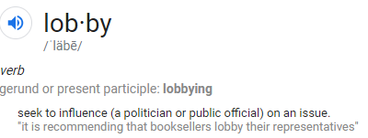
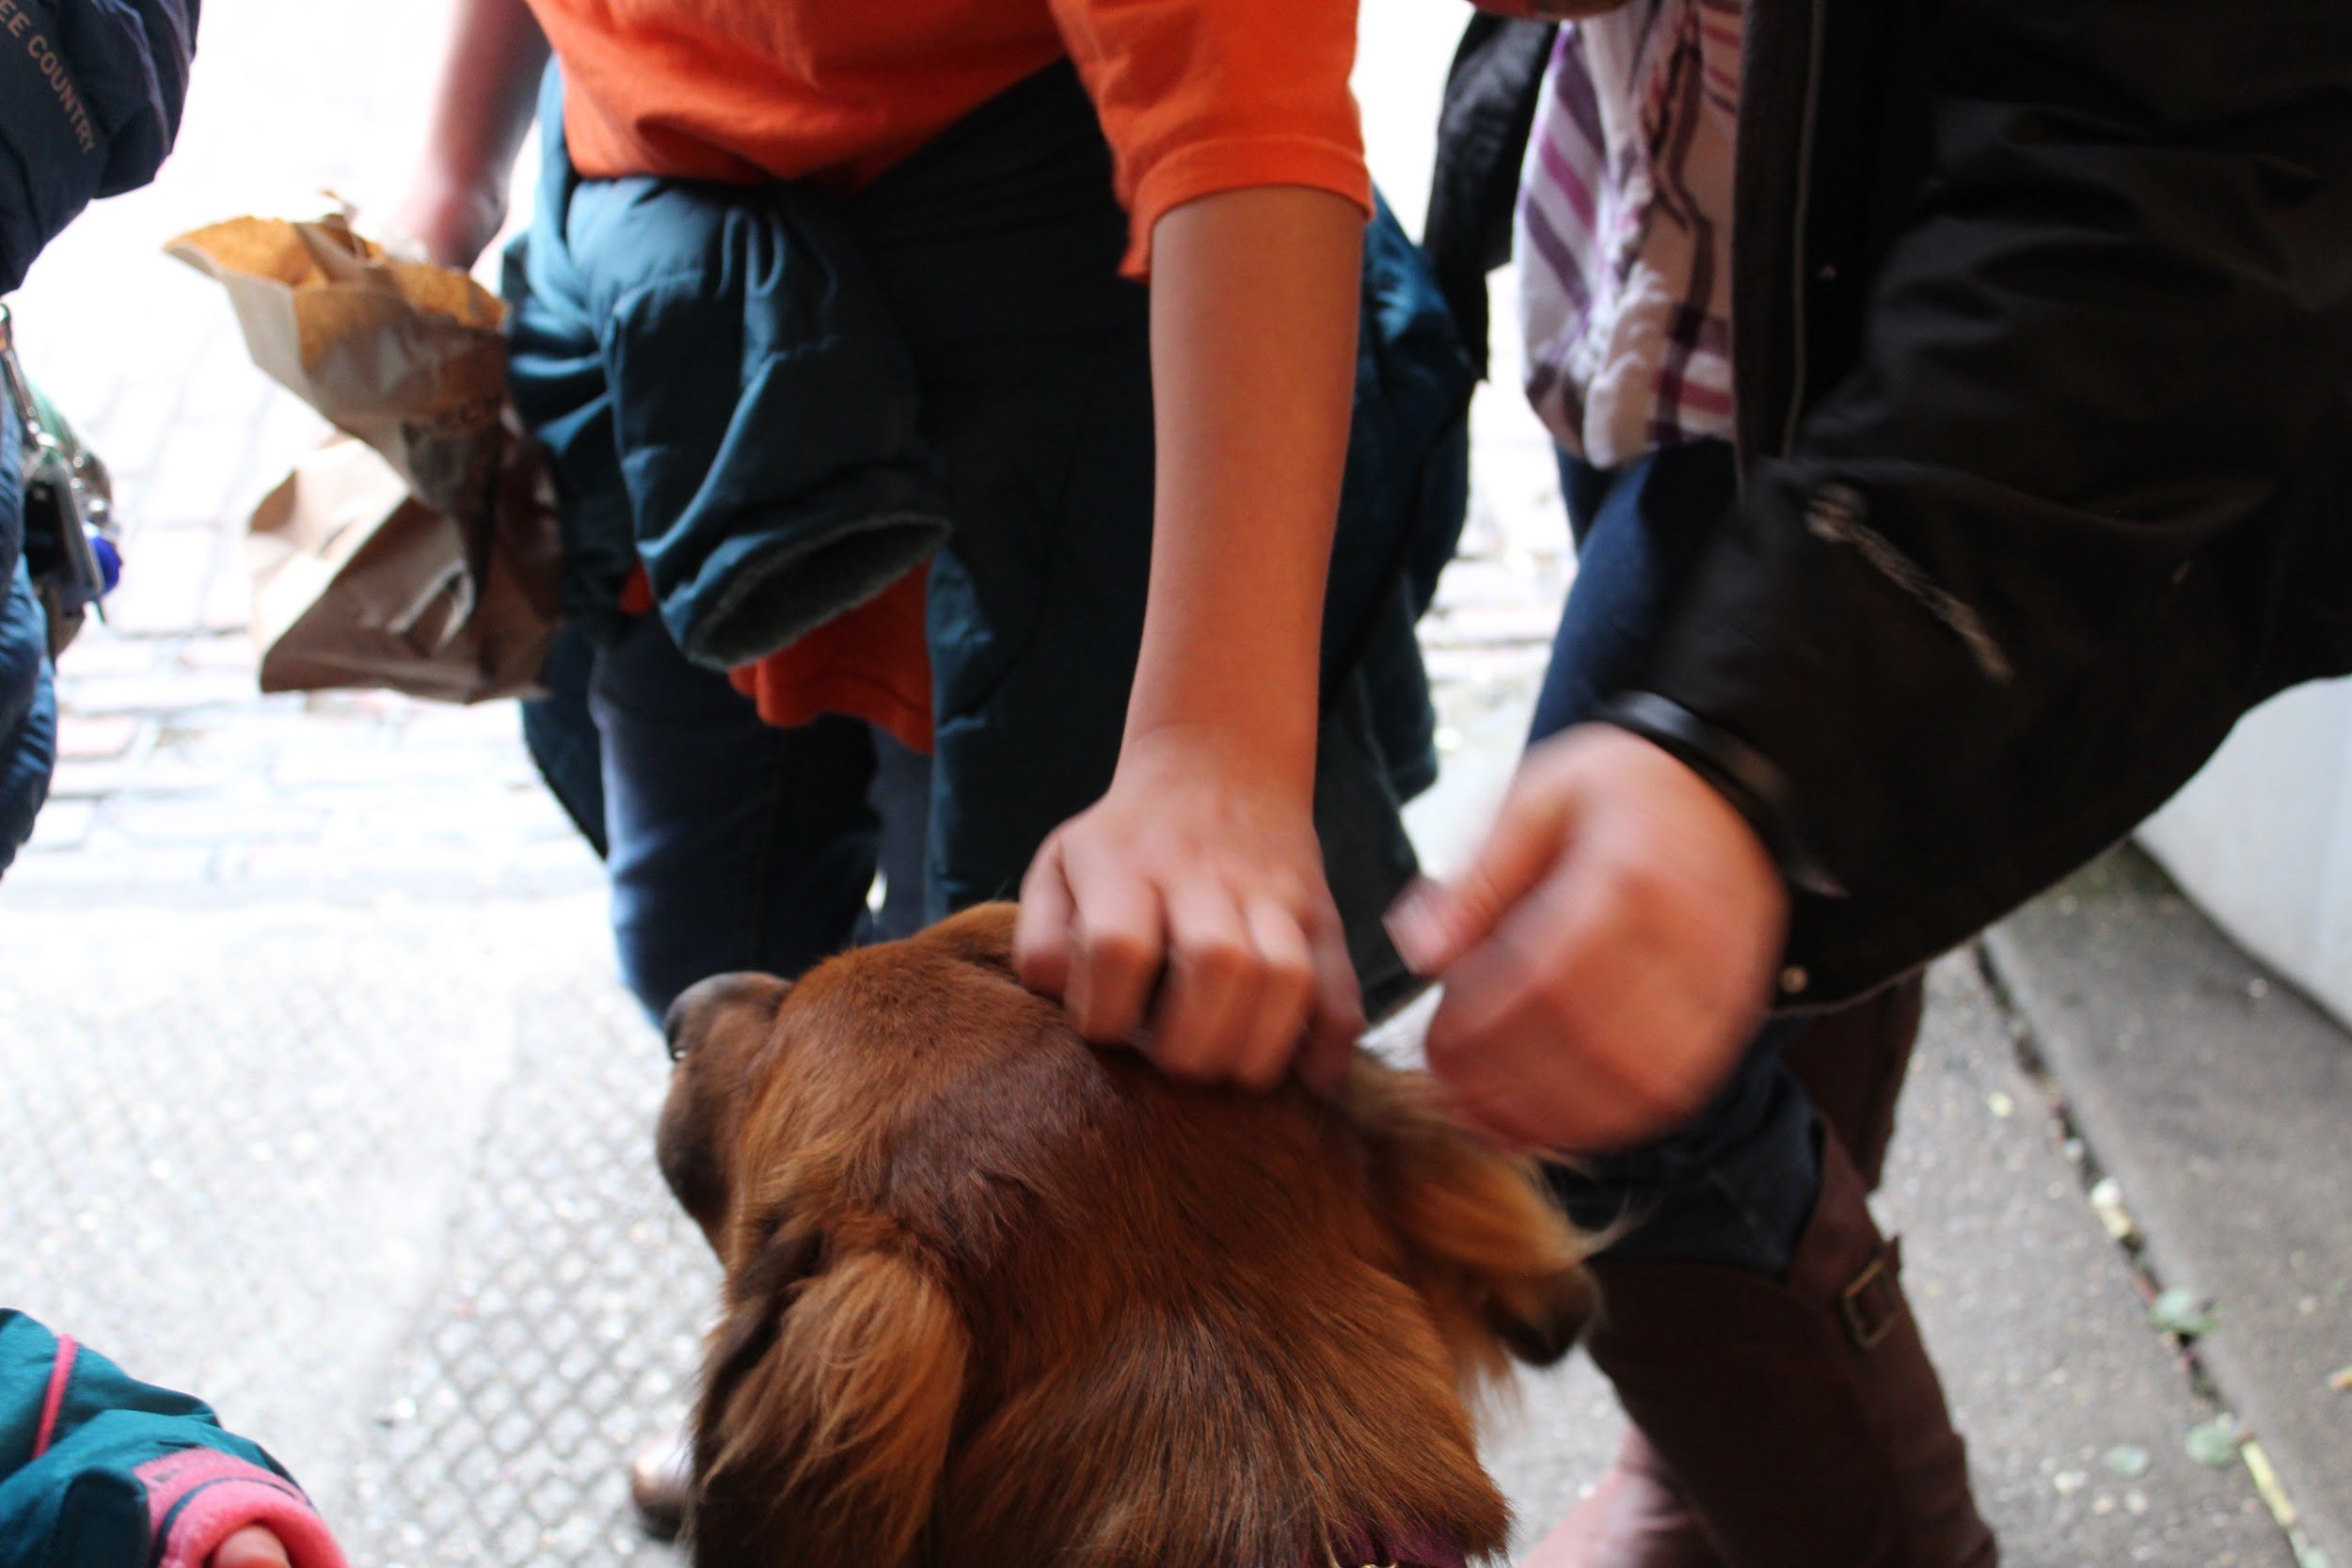
Back to it
I am a employed by the Office of Civic Engagement (OCE) in the Associated Students.
I work with the OCE to promote student engagement and get students involved in legislative action and other forms of advocacy.
I lobby legislators on behalf of Western students. I work with other student lobbyists and the Washington Student Association

Slide 4
Washington Student Association (WSA)

Slide 5
The WSA is a non-profit *non-partisan organizing body representing all students attending Washington State's institutions of higher education to the Washington State Legislature.
In simpler terms:
It’s a bunch of students from Washington State 4-year and 2-year colleges that work together to advocate for students in the government. We also work with student government’s on-campus to engage and empower students in advocacy.
It’s one of the few student-run lobbying organizations in the nation!
*non-partisan - no association with a political party, however as a non-partisan organization we can identify a party that is receptive to our agenda-items.

Slide 6
How is it structured?
Executive Committee - elected by the General Assembly to oversee WSA operations.
Board of Directors - One leg. liaison from each campus and the student government head (or representative).
General Assembly - body open to all students. This votes on what issues will be on the legislative agenda
Executive Committee
Board of Directors
General Assembly

Slide 7
The WSA Legislative Agenda (Here)
The WSA legislative agenda is a list of issues that all student liaisons work together on to get passed in the legislature.
One way to get momentum on a piece of legislation that benefits students is to work with other campuses in Washington to push for the same issues. It gets more legislators interested in our bills if they believe it’s what their voters want.
This doesn’t mean that Western can’t lobby on its own issues! In fact, we have “Lobby Days” where, in the past, we brought students free-of-charge to Olympia to meet with legislators and advocate on the WWU Legislative Agenda.

Slide 8
What is the role of the DOLA in the WSA?
The WSA is the only U.S. student-run lobbying organization with a legislative liaison program -it organizes the liaisons from each campus to work directly with legislators.
This includes providing support in issue research and legislative bill tracking, which is a big help to me.
Student liaisons are the most effective way to influence legislators.Lobbying as the WSA gives students a crazy amount of political influence.
The WWU AS Board of Directors must vote to approve the WSA agenda before I officially lobby for it.

Slide 9
How will the WSA help get Western student’s represented in the legislature?
The WSA is a resource for me to connect with legislators by maintaining the relationship between each new liaison and legislators they worked with in the past.
As a result, I can quickly build the relationships and institutional knowledge I need to get you connected to legislators.
While I meet with legislators to lobby on the WSA agenda, I also work on the Western-specific Associated Students legislative agenda, which you can get involved in creating*!
*Apply for the Legislative Action Committee (LAC) or follow @wwuas_oce on instagram and @aswwulobbyist for opportunities to submit agenda items and give feedback on agenda drafts!

Slide 10
There’s a second part to the WSA Mission!
The WSA also works with student associations on each campus on voter engagement, civic education, and student empowerment
Important Note - Our membership in the WSA is paid for by student dollars. It is a part of the S&A fee in your registration fees. The dues are $1.00 per student/quarter.
So the WSA also works for YOU and you have a voice in how it works.
Also, they are asking to increase the fee over the next three years to get to $3.00 per student/quarter. That is something students will eventually vote on!

Slide 11
2010
SB 6409 – Redirecting state lottery revenues to financial aid
SB 6444 – Retained funding for Work Study, State Need Grant, WAVE, WA Scholars, GEAR UP, & Passport to College.
SB 6562 – Defeated effort to allow institutions to set tuition locally.
2011
funding for the state match funding for on campus child care facilities was restored.
2012
zero-cuts budget to Higher Ed, the first no-cuts budget in almost a decade.
WSA ensured early class registration for all Student Veterans, as well as in-state tuition for active military moved into Washington.
2013
Tuition freeze for the 2013-14 academic year.
Recent WSA Victories

Slide 12
2014
DREAM Act (HB 1817)
One year waiting period for veterans reduced (SB 5179)
HB 1043: Limiting differential tuition
2015
Tuition Reduction (5%→15%) First time in over 30 years!
2016
Full “backfill” for universities
Prevented 2,000 students from being cut from SNG
Created statewide Disability Student Transfer Task Force
2017
SB 5022:Increased transparency and consumer protections for student loan borrowers
HB 2037: (Frame) Reauthorization of Disability Taskforce
SB 5764: (Wellman) Protections for Campus-Based Victim Sexual Assault Advocates
SB 5472: (Pearson) Expand Number of Ballot Drop Boxes in the State of Washington
More Recent W’s

Slide 13
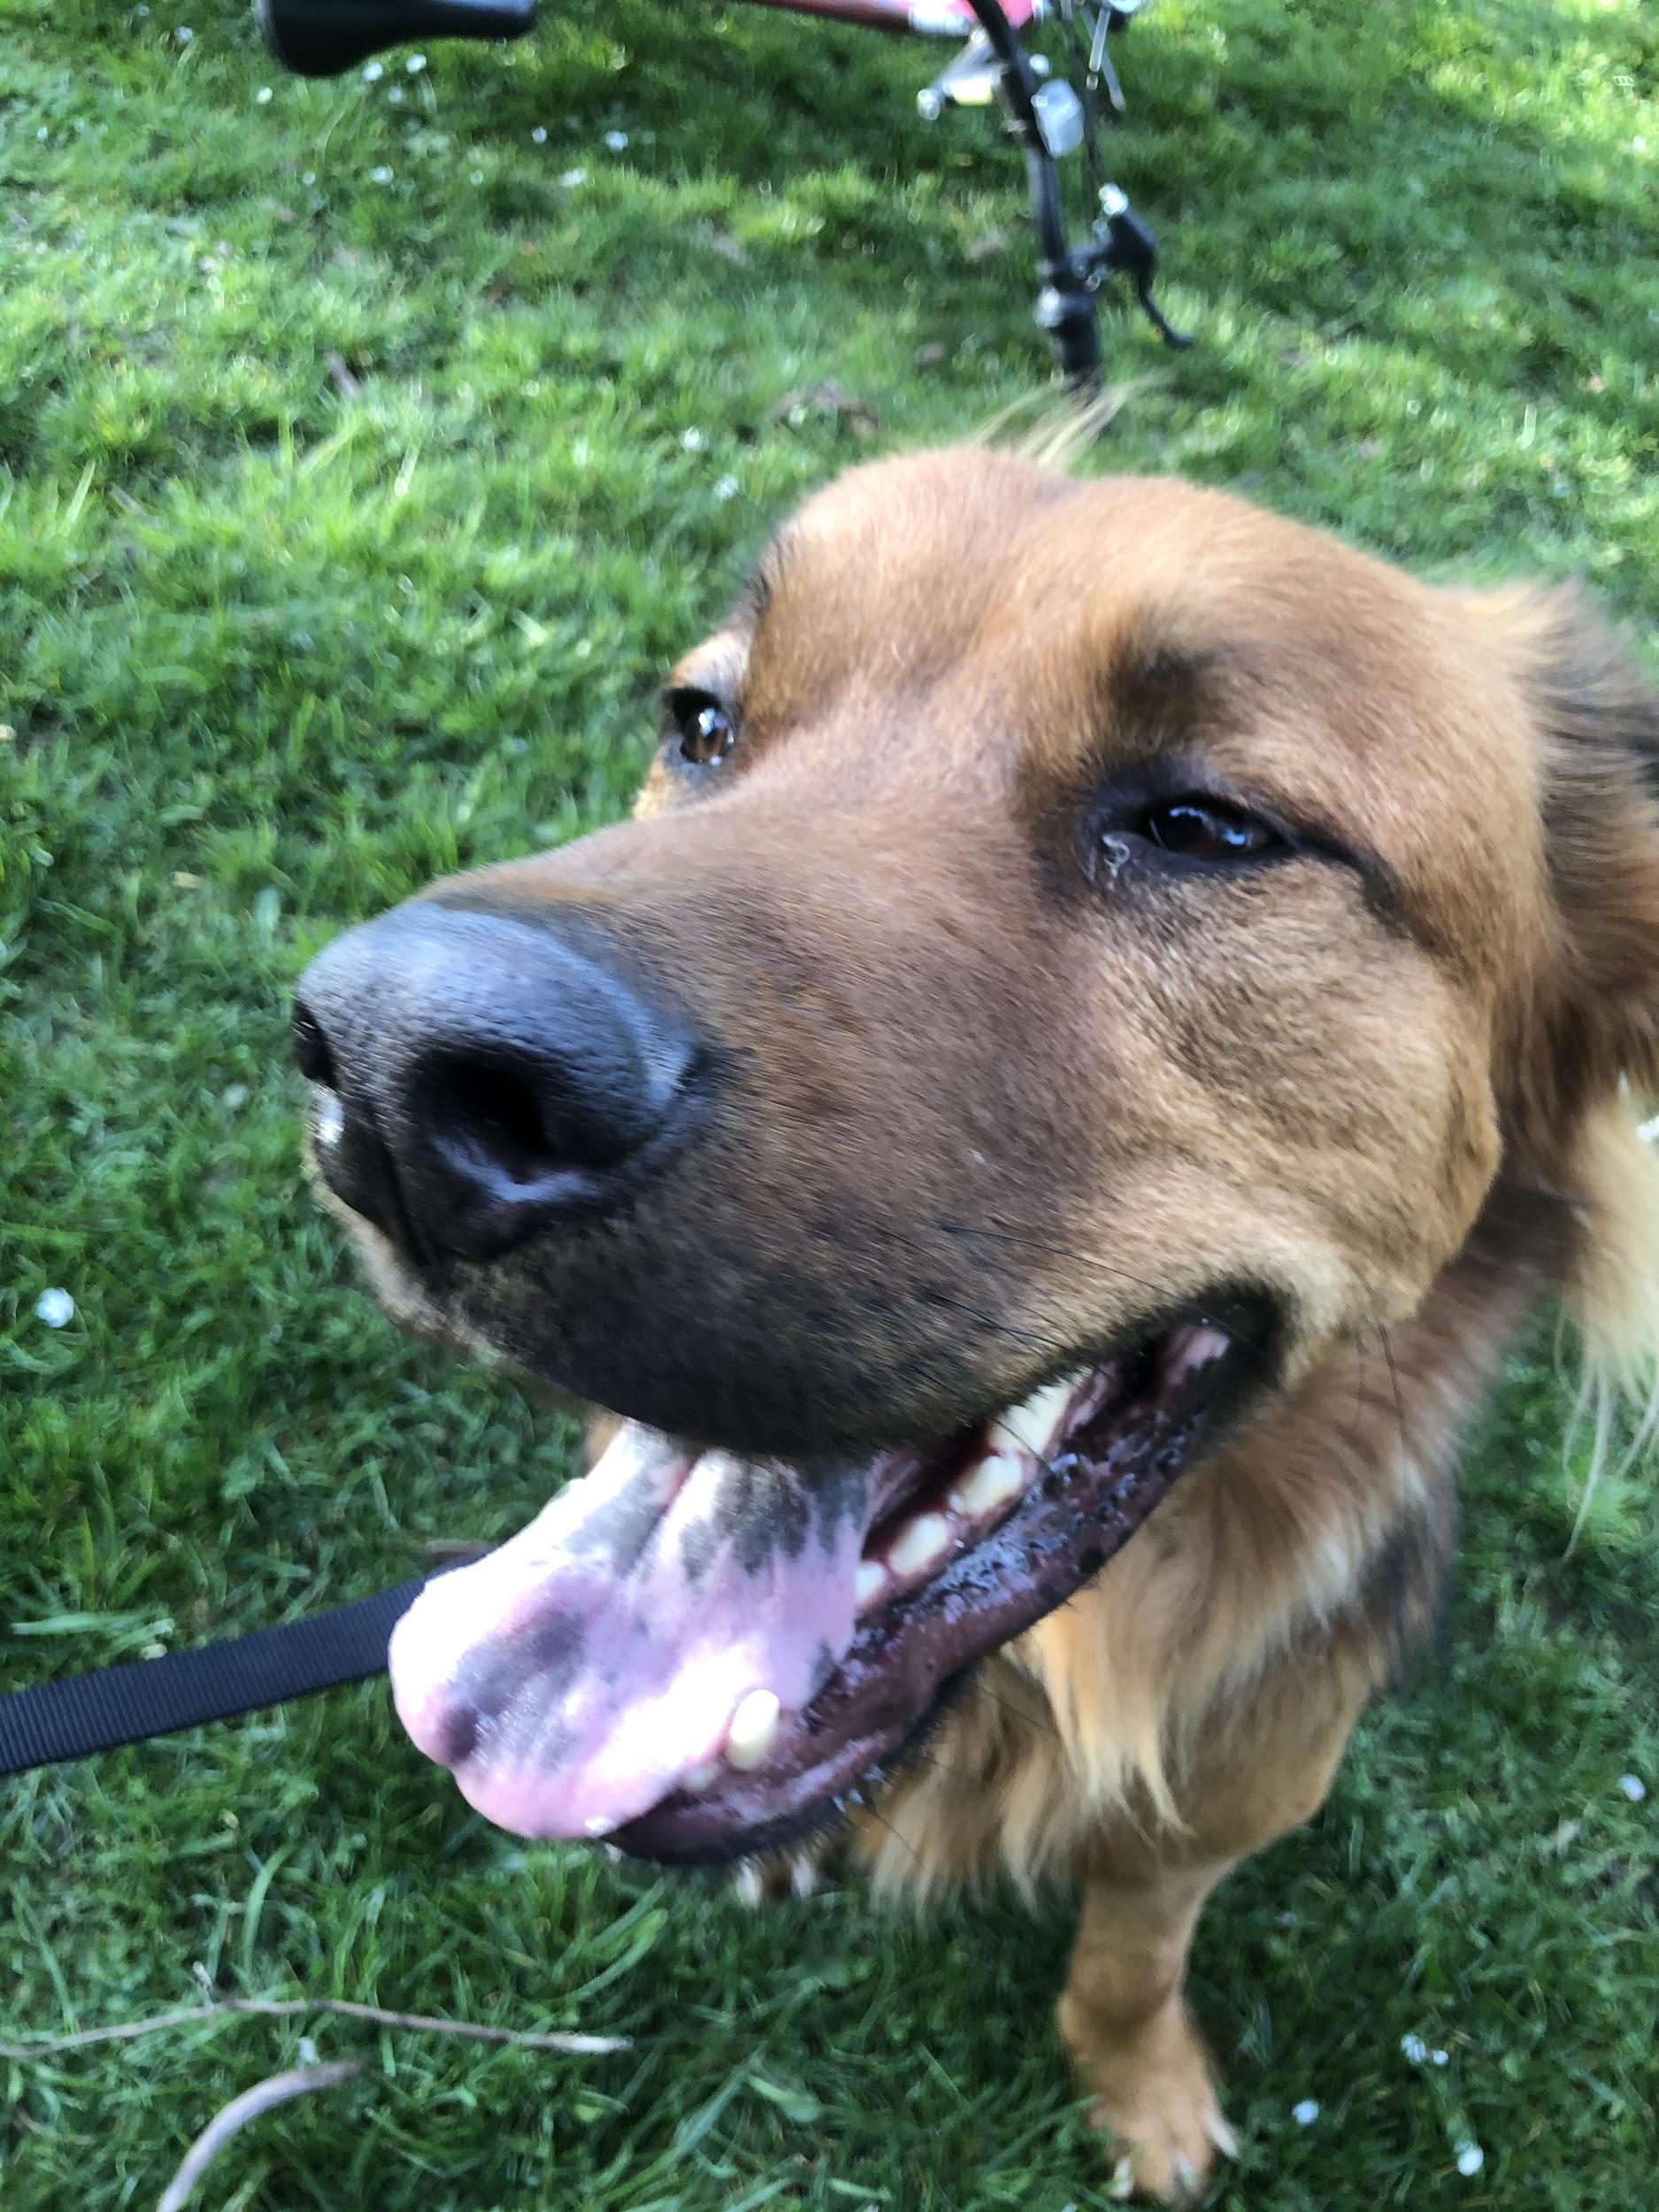
2018
Student Loan Bill of Rights
Service and Activity Fees Decoupling
Increased State Need Grant Funding
Dream Act 2.0 - Secured State Financial Aid for Undocumented Students
Voter Registration Package (same-day, Automatic VR, Pre-reg for 16/17)
Open Educational Resources
2019
Washington College Grant
Interprofessional Education
Religious Accommodations
Refinanced Student Loans
Homeless Student Support and Study
Anotha One

Slide 14
2020
Secured more $ for the WCG
SB 6313: Creates Student Engagement Centers
HB 2513: Prohibits transcript withholding practices
SB 6561: Establishes the Undocumented Student Loan Program
SB 5395: Comprehensive Sex 7 Consent Education
HB 2327: Review faculty in the hiring process for sexual assault allegations/misconduct
SB 6142: Creates the Washington Common Application
SB 6141: FAFSA Day
HB 2266: No discrimination against breastfeeding
SB 5197: National Guard scholarships
WOOT
To learn more about these bills, you can look them up by number or keyword at https://app.leg.wa.gov/billinfo/

Slide 15
What's on the WSA Agenda this year?

Slide 16
WWU Brought 5 of the proposals!*
Eliminating the EdTPA*
Eliminating the SAT/ACT in undergraduate admissions
Returning to previous Title IX regulations*
Requiring transparency in allocation of GEER/CARES funds*
Requiring lectures to be recorded
Mandatory DEI training*
Barring UPD from hiring police officers with disciplinary records*
https://docs.google.com/document/d/1-XSdaqcFX2Vn3cLizAv-lVKJhPt_f6aAzMjkfDkzGlk/edit?usp=sharing
Note: *one proposal was not approved – raising statewide minimum pay for graduate students

Slide 17
The End
Also this is such a flexible position and I’m always happy to hear feedback and suggestions on how my position can best support students.
Email me @ aslegislativeliaison@wwu.edu

