Slide 1
2023 AS Elections
Winners & Trends

Slide 2
2019 to 2023 Turnout

Slide 3
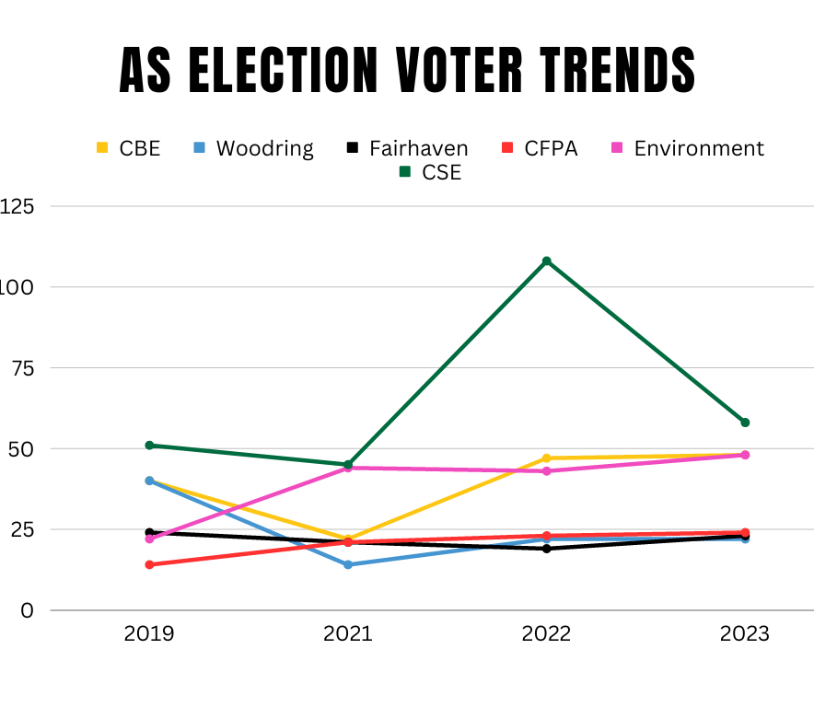
Trends: Senate

Slide 4
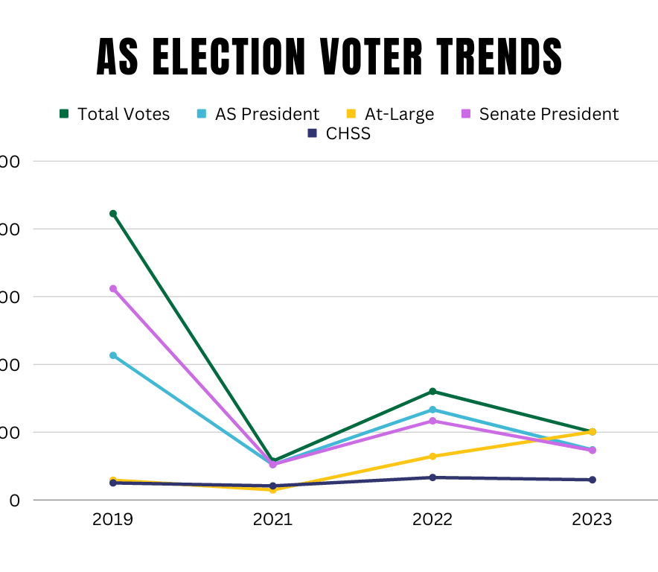
Trends: Exec & CHSS

Slide 5
Winners
AS Pres: Keara Ryan
Senate Pres: Gabe Wong
VP Activities: Noah Schexnayder
VP Student Services: Sophie Snyder
VP Diversity: Morgan Whitt
VP Governmental Affairs: Erin Godwin
VP Sustainability: Liam Pratt
At-Large: Mariana Flores, Autumn Kay-Chapman, James Dinh, Lily Van Mullem
CBE: Dacey Durbin
CENV: Meli Bernal, Lola Thompson
CHSS: Yasmin Lamas Flores, Miguel Angel Acuna-Martinez
Woodring: Lily Duong, Matt Condon
Fairhaven: Quincy Ingalls, Miguel Estevez
CFPA: Ella Byerly, MJ Dizon
CSE: John Hardgrove, Marv Locke
Grad: Britta Eschete

