Slide 1
WWU MICROMOBILITY COUNTERS
SEJF Grant Team
Students: James Detke, Malcolm Duncan-Graves, Seb Genge
Employees: Beth Hartsoch, Steve Hollenhorst, Andrea Reiter
Notes:
James

Slide 2
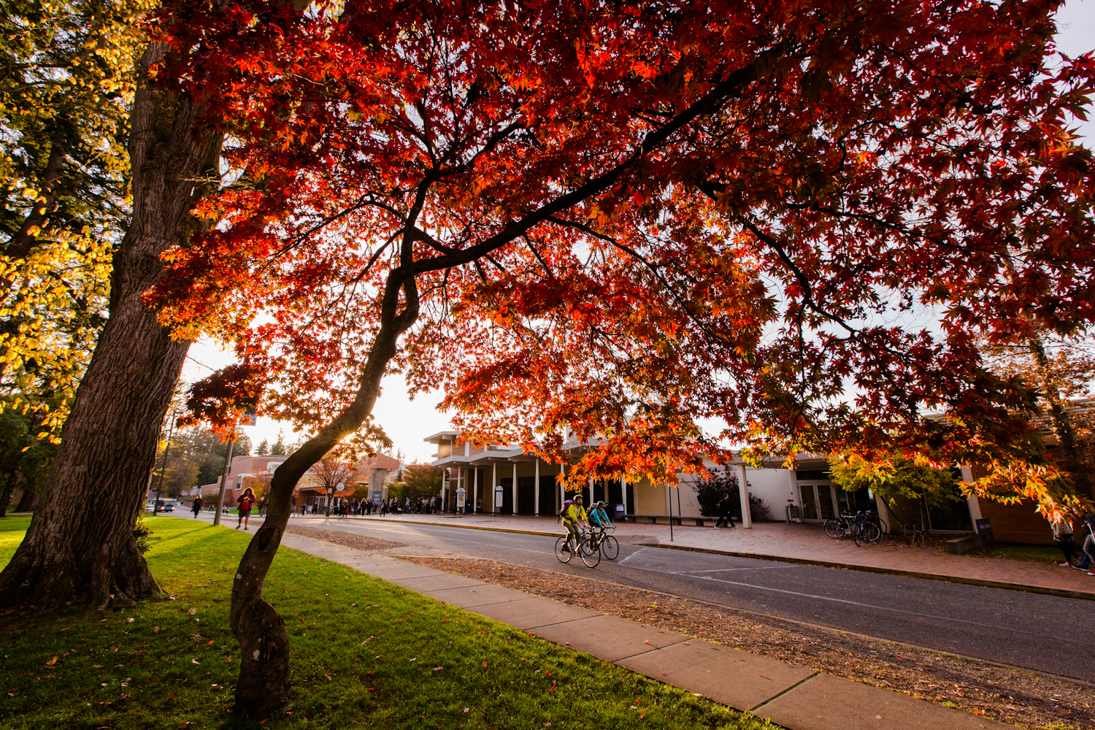
Project goal
Install 3 bike counters on campus
Collect accurate and useable data for WWU Transportation Services and other organizations to guide infrastructure development and micromobility programming.
Notes:
Jame

Slide 3
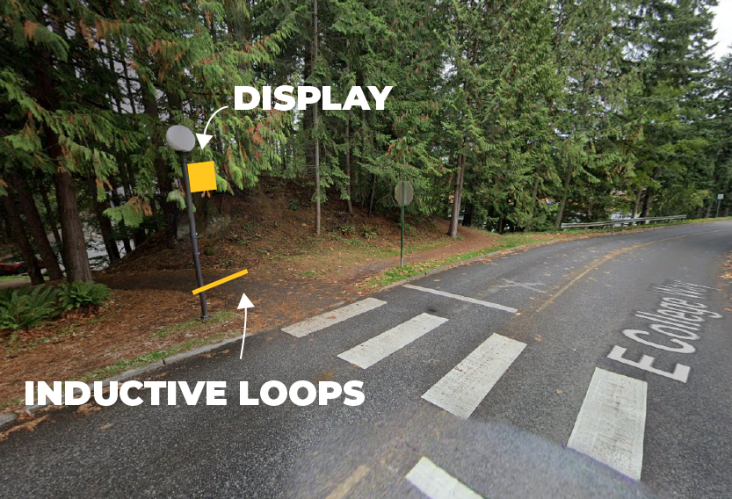
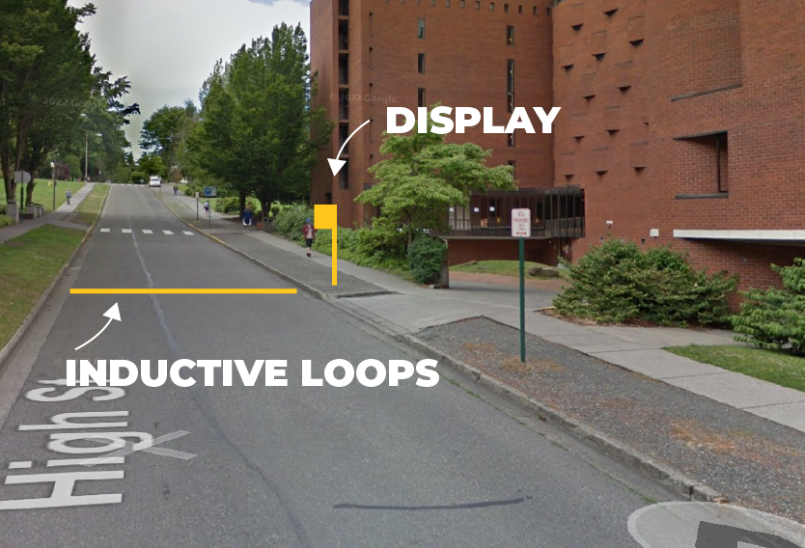
Counter locations
2 south campus locations, 1 north campus location
Eco-display Classic+ at Wade King Recreation Center
Eco-display Compact units on Fairhaven Trail and High Street
Notes:
Malcolm

Slide 4
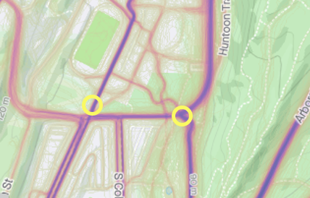
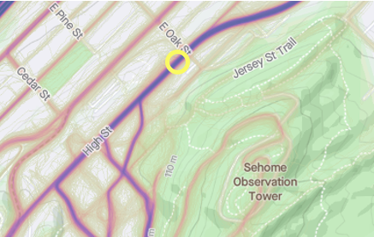
Location rationale
Vast majority of south campus bike traffic moves through the Fairhaven Trail and path alongside the Rec Center
Most of north campus traffic moves through high street.
These three locations would catch the vast majority of the traffic passing through and entering campus
Notes:
Malcolm

Slide 5
Why Eco-Counter?
Met with both Eco-Counter and MetroCount
Discussed efficacy of each product with WSDOT, PSU, City of Seattle and several other users
Read reports from MNDOT, MassTrails, and NACTO on accuracy and choosing technology, including video monitoring using AI software
Eco-Counter is longer lasting, has continued customer support, and has a higher accuracy rate than MetroCount at 95%
Eco-Counter has the added bonus of integrating with state and local data
Notes:
Seb

Slide 6
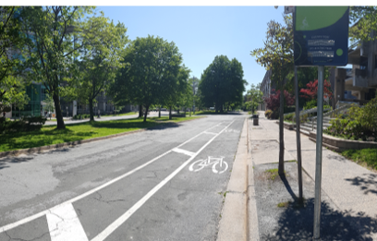
Equipment
EcoDisplay Classic+
EcoDisplay Classic+ is more visible, and would be placed in front of the Wade King Student Recreation Center
Can be branded with Western colors and logo, Has the ability to display more than 5 metrics with real time updates
EcoDisplay Compact
EcoDisplay Compact is smaller, more affordable, and vandalism resistant. This model would be placed on the Fairhaven trail and High Street
Can be branded with Western colors and logo, Has the ability to display 2 real time metric
Has simpler install process
Notes:
Seb

Slide 7
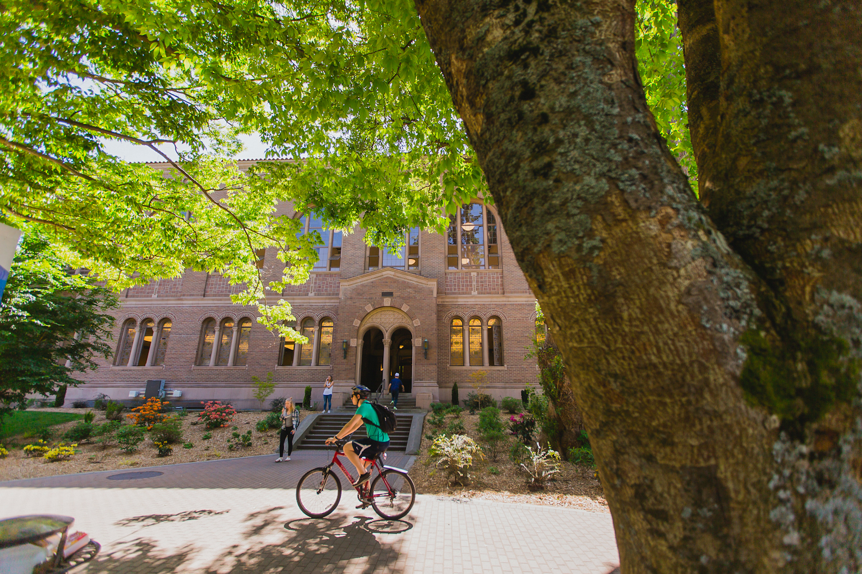
Intended Audience/Community Benefits
Benefits to the community
Data will support future investments in infrastructure.
Data accessible to anyone including those doing analysis related to transportation.
Data will provide justification for grant applicants and facilitate accurate goal setting.
The displays will provide riders and other pedestrians on campus awareness of micromobility use.
Data will help campus safety organizations make predictions of micromobility use helping limit conflict and create future micromobility policies.
Intended Audiences
Transportation Services, Facilities Management, and Capital Planning and Development
Students and faculty for statistical or data analysis
SEJF grant applicants
Riders and other pedestrians
Campus police and safety
Notes:
Seb

Slide 8
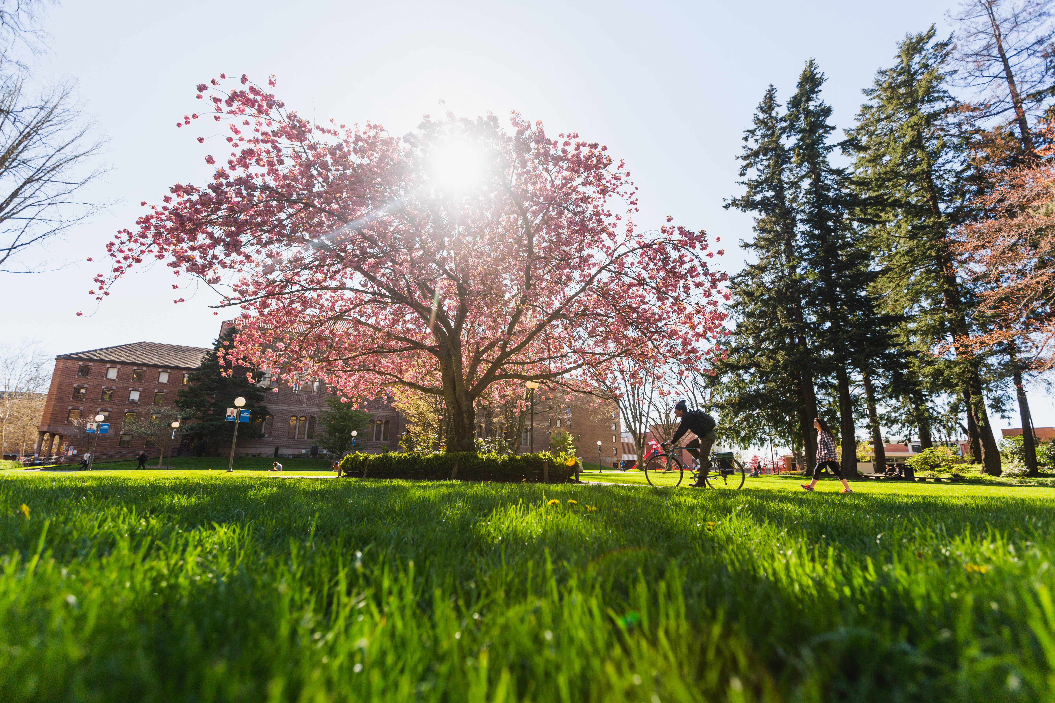
Alignment with Sustainability goals
UN Sustainable Development Goals
Sustainable Cities and Communities: project will assist in shifting community from cars to micromobility by encouraging riders and providing information needed for planning.
Climate Action: Our project would help reduce emissions from ICE Vehicles through guiding initiatives to increase ridership
Good Health and Wellbeing: Biking and in particular commuting by bike provides a wide range of physical and mental health benefits
Western sustainability Action Plan
Transportation: The project will provide data that will allow for a better understanding micromobility use, guide efficient resource use, and help the school to understand shifts in mobility patterns.
Built Environment: The project will provide visible indicators of ridership to those entering and leaving campus. The data provided will help in making infrastructure related decisions.
Curriculum and Research: The project will provide data for use by students and faculty in research and class work. The data can help users improve their data analysis skills and gain a better understanding of how to use transportation data.
Notes:
James

Slide 9
Project budget
Budget item | Cost per Item | Quantity | Cost
Materials-Eco-Display Classic | $29,385 | 1 | $29,385
Materials-Eco-Display Compact | $9,900 | 2 | $19,800
Shipping Cost | $3,000 | 1 | $3,000
Installation Assistance | $8,000 | 1 | $8,000
Location 1 Installation, Facilities | $8,000 estimated | 1 | $8,000
Location 2 Installation, Facilities | $5,000 estimated | 1 | $5,000
*Location 3 Installation, Facilities or City of Bellingham | $6,000 estimated | 1 | $6,000
*Location 3 Contractor for Engineering Plans | $10,000 estimated | 1 | $10,000
*Location 3 Permitting Costs | $10,000 estimated | 1 | $10,000
Total project budget |  |  | $99,185
Notes:
James

Slide 10
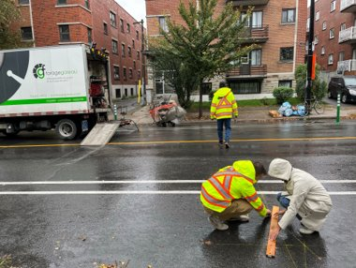
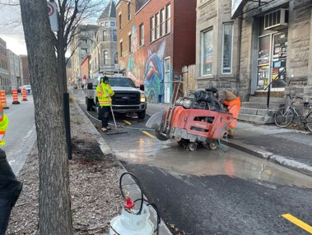
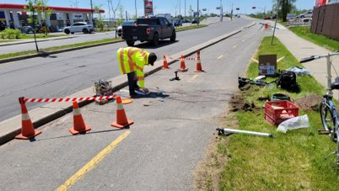
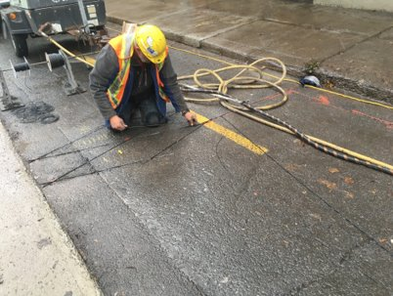
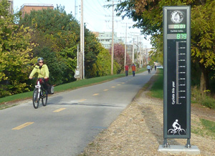
Installation Steps
Drawing and cutting loops
Coiling and sealing loops
Installation of display
Notes:
Seb
Eco-Counter requires one of their employees to be onsite during installation. They will be available to guide the facilities team to ensure the counters are installed to the specific requirements of Eco-Counter.
Fairly simple installation process. Eco-Counter provides clear protocol on installation details.

Slide 11
Project Longevity
Transportation Services in charge of long-term upkeep
Eco Counters have a 15 year+ life span
ATF (Active Transport Fee) Funds already approved for 15 years of upkeep costing $73,650
Maintenance cost approximately $3,000 a year.
Transportation Services will have yearly validation counts to make sure that the systems are collecting accurate data
Validation protocol from NACTO and City of Vancouver BC
Notes:
Malcolm

Slide 12
Project Support
Facilities Development & Operations:
Project supported by Amanda Cambre, Forest Payne, Rick Benner, Lisa Brennan, and Steve Hollenhorst
Transportation Services
Shelby Zimmerman, Andrea Reiter
City of Bellingham
Actively seeking support from Eric Johnson, Public Works Director
Partnership on north campus location would drastically decrease costs, improve project outcomes
Would look to connect City’s existing counters with our data
Notes:
James

