Slide 1
Sustainable Office Certification Kit Grant
Maia Heffernan

Slide 2
What is the Sustainable Office Certification (SOC)?
A checklist/scoresheet for offices and departments for tracking progress on sustainability in their office spaces
See the Sustainable Office Certification!
A way for staff and faculty to directly engage with the SAP and Western’s Strategic Goals
An avenue for building a culture of sustainability on campus

Slide 3
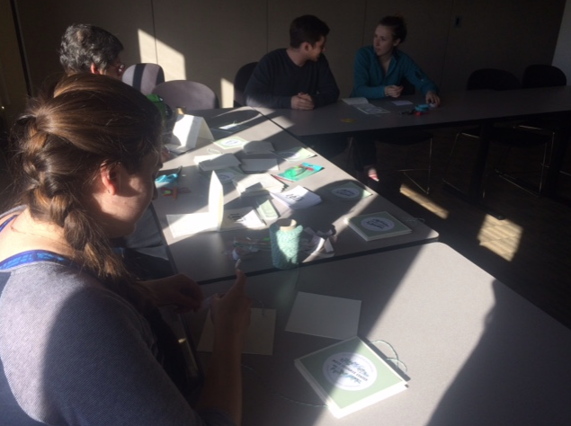
A History of the Sustainable Office Certification
Program initiated by the Office of Sustainability in the 2016/2017 school year
Put on hiatus due to a change of management followed by the pandemic
The SEI brought it back this May and is working on outreach and engagement

Slide 4
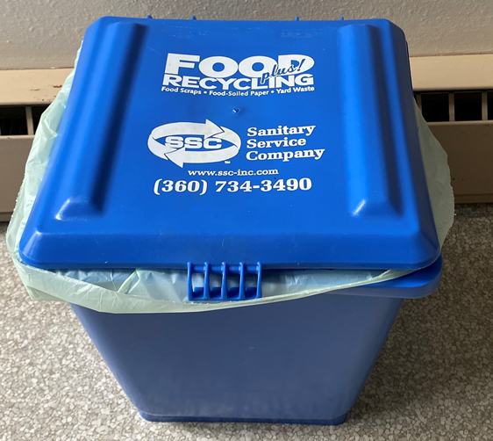
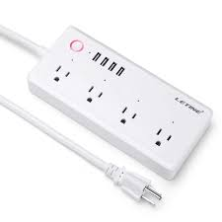
The grant: Asking for a “starter kit”
Compost bins and bags, LED lightbulbs, power strips, stainless steel water bottles, materials for posters and certificates
Funding for a celebration at the end of the year to award certified offices
Small grant: $4,840.50

Slide 5
SAP chapters
Built Environment
Campus and Community Engagement
Curriculum and Research
Procurement
Waste

Slide 6
This project falls under several SDGs

Slide 7
A quick summary
What is the SOC
History of the SOC
The grant ask
SAP chapters
SDGs

Slide 8
Questions?

